Slide 1
Source Coding

Slide 2
What is Data Compression?

Slide 3
What is data compression?
Data compression is the representation of an information source (e.g., data file, speech signal, video signal) as accurately as possible using the fewest number of bits
Compressed data can only be understood if the decoding method is known by the receiver

Slide 4
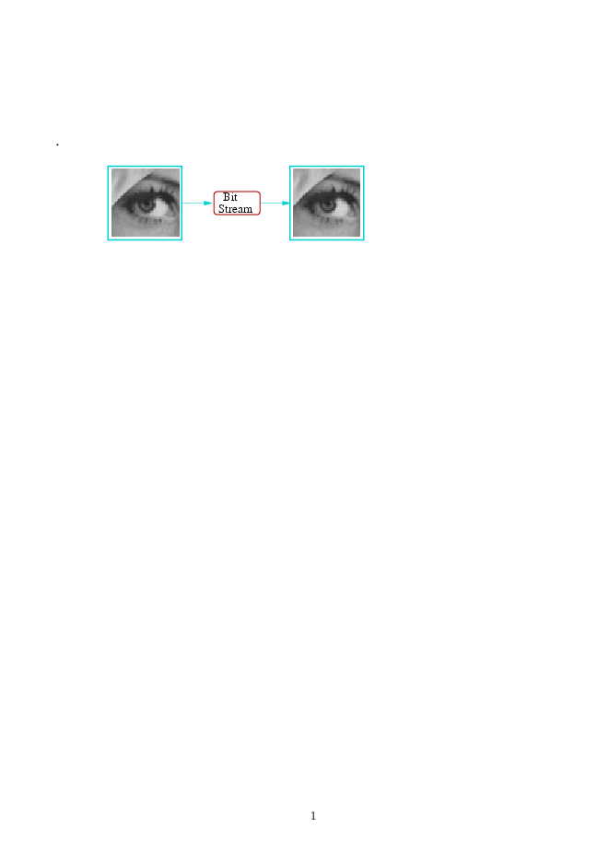
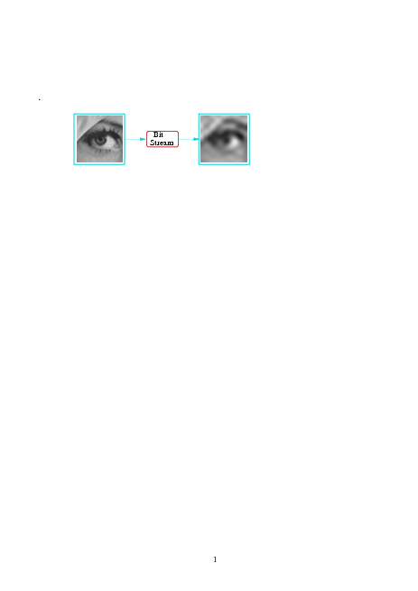
Source Coding
Lossless
(text, programs)
Lossless compression: the compressed image/video can be decompressed to be identical to the original
Lossy
(images, videos)
With lossy compression, the image is degraded, mathematically not identical to original. Data compression introduces a distortion of the source.
Notes:
Two main coding types are used in Mobile Communications
Speech Coding – source coding
Reduces the redundancy to minimise the bandwidth
Error Coding – Channel Coding Techniques
Increase the redundancy to reduce errors and improve reliability

Slide 5
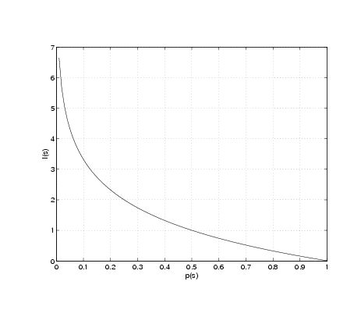
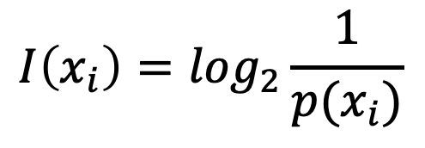
Source Information
Let X be a discrete random variable taking on values x₁, x₂, … x_{j} from a finite alphabet A
Probabilities of occurrence are p(x₁), p(x₂), …p(x_{j})
I(x)
P(x)
The information associated with symbol s_{i} is defined to be
$$I\left(x_{i}\right)=\log_{2}\frac{1}{p(x_{i})}$$
5

Slide 6
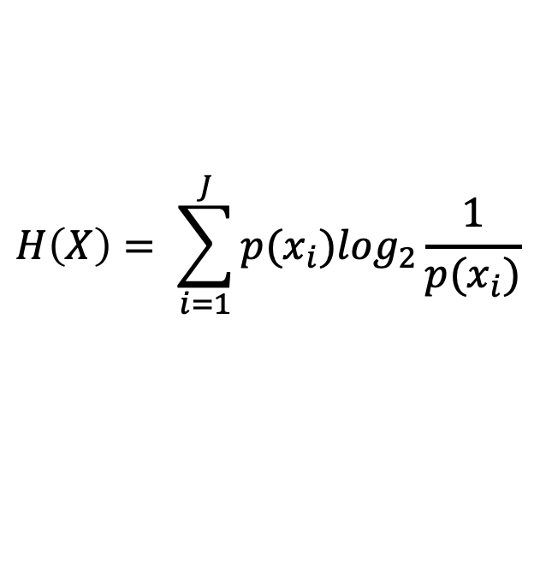
Entropy
(First-order) Entropy is a measure of the uncertainty of a random variable.
Entropy is the average information per symbol
Entropy is expressed in bits
Entropy of a fair coin toss is 1 bit
Average length of the shortest description of the random variable
$$H\left(X\right)= \sum_{i=1}^{J}{p(x_{i})\log_{2}\frac{1}{p(x_{i})}}$$
6

Slide 7
Entropy

Slide 8
Source Information
Sunrise Time – not that much informative
Black Hole Pic – highly informative
8

Slide 9
Example 1
Let
Then
$$H\left(X\right)={−p log}_{2}p −\left(1−p\right)\log_{2}\left(1−p\right)≝H(p)$$
Entropy of a fair coin toss is 1 bit.
Or in other words p=0.5 → H(p)=1
9

Slide 10
Example 2
Let
Then, the entropy of X is
$H\left(X\right)={−\frac{1}{2} log}_{2}\frac{1}{2}{−\frac{1}{4} log}_{2}\frac{1}{4}{−\frac{1}{8} log}_{2}\frac{1}{8}{−\frac{1}{8} log}_{2}\frac{1}{8}=\frac{7}{4}$ bits
What is the minimum number of questions you need to determine X?
“Is X = a?”
“Is X = b
“Is X = c?”
The resulting expected number of binary questions required is 1.75.
The minimum expected number of binary questions required to determine X lies between H(X) and H(X) + 1.
10

Slide 11
Thank You

